Slide 1
New York & LA Parking Violation Tickets
Leena Singh
Prayas Pandey

Slide 2
RoadMap
Background and
Hypothesis
Datasets
Data Pre-processing
Analysis Approach
Results
Visualization Reports

Slide 3
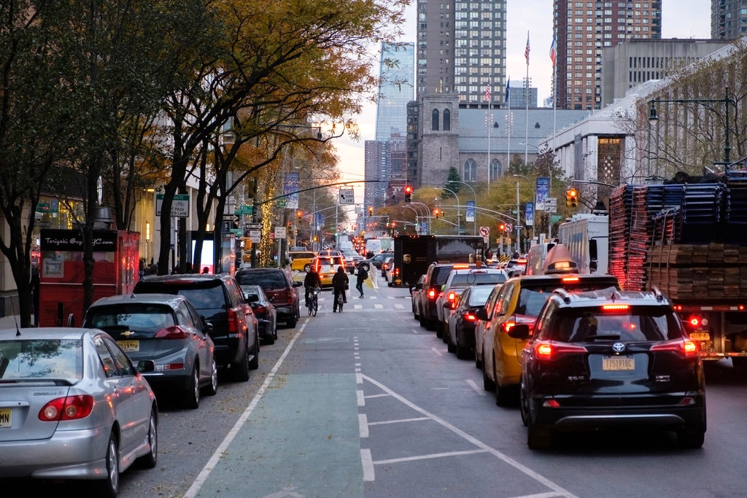
Hypothesis and Background
HYPOTHESIS:
-More parking violation tickets are issued during summer season
Parking violation tickets
Focusing on New York City and Los Angeles

Slide 4
Relatable Analysis
Motivation:
https://1qbtdvta4z51b6jya2plpcm1-wpengine.netdna-ssl.com/wp-content/uploads/2016/11/NYC-Parking-Ticket-Report_parking_Samuel_Ackerman5.pdf
Which is the most common type of violation?
During which month there were most violations?

Slide 5
Datasets
Data sources :
NYC
https://data.cityofnewyork.us/City-Government/Parking-Violations-Issued-Fiscal-Year-2020/pvqr-7yc4/data
ParkingViolationCodes Nov 2020.xlsx
https://www.nyc.com/visitor_guide/weather_facts.75835/
LA
https://www.kaggle.com/cityofLA/los-angeles-parking-citations
https://www.universaltraveller.com.au/destinations/los-angeles/weather
http://www.laalmanac.com/weather/we01.php

Slide 6
Data Pre-Processing
For NYC dataset
Data cleaning using Microsoft Power BI:
Removed columns
Removed blank cells
Removed spell errors (e.g. BLACK,BLK,BLCK)
Changed datatypes as required
Size of the dataset - 1.1GB (7.9M to 4.2M)

Slide 7
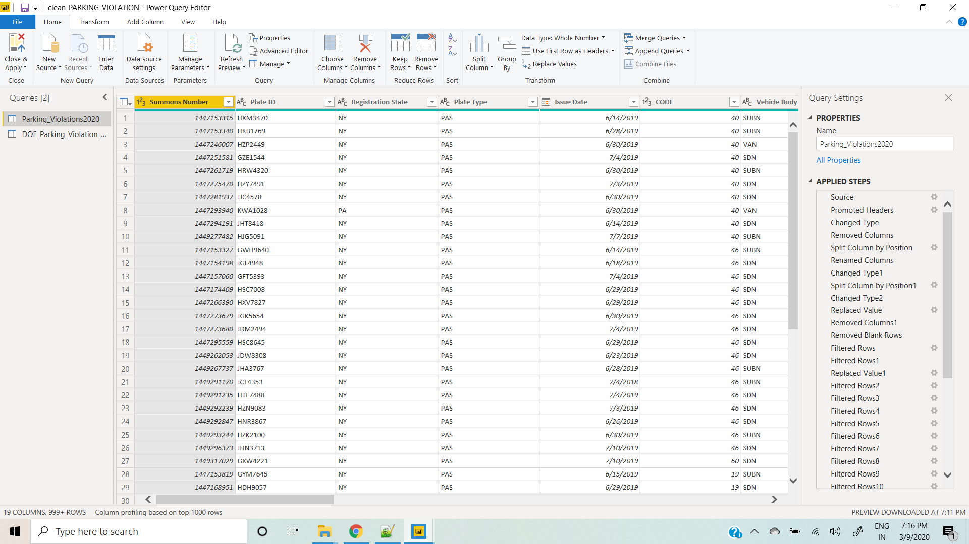

Slide 8
Data Pre-Processing
For LA dataset
Data cleaning using Microsoft Power BI:
Removed columns
Removed blank cells
Changed datatypes as required
Size of the dataset - 1.35 GB (9.6M to 8.8M)

Slide 9
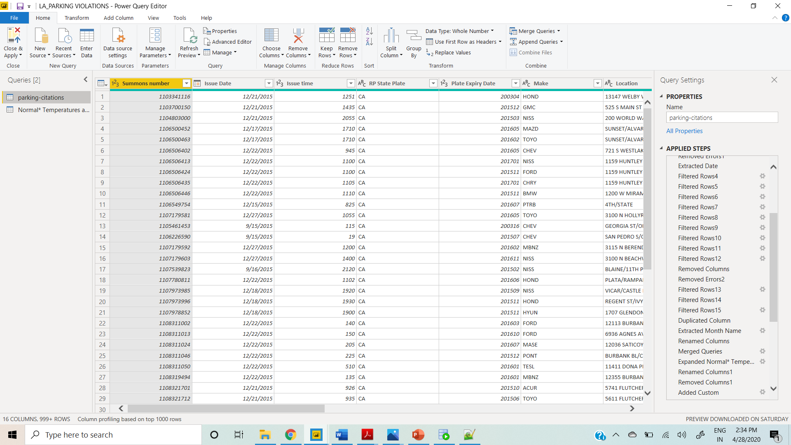

Slide 10
2. Data Merging
Merged dataset DOF Parking Violation
Common column - VIOLATION CODE (Inner Join)
Columns added – VIOLATION DEFINITION, FINE
Merged dataset Weather conditions for NYC
Common column – Month (Inner Join)
Columns added – Avg High Temp. , Avg Low Temp. , Avg Mean Temp.
(all in Celcius)

Slide 11
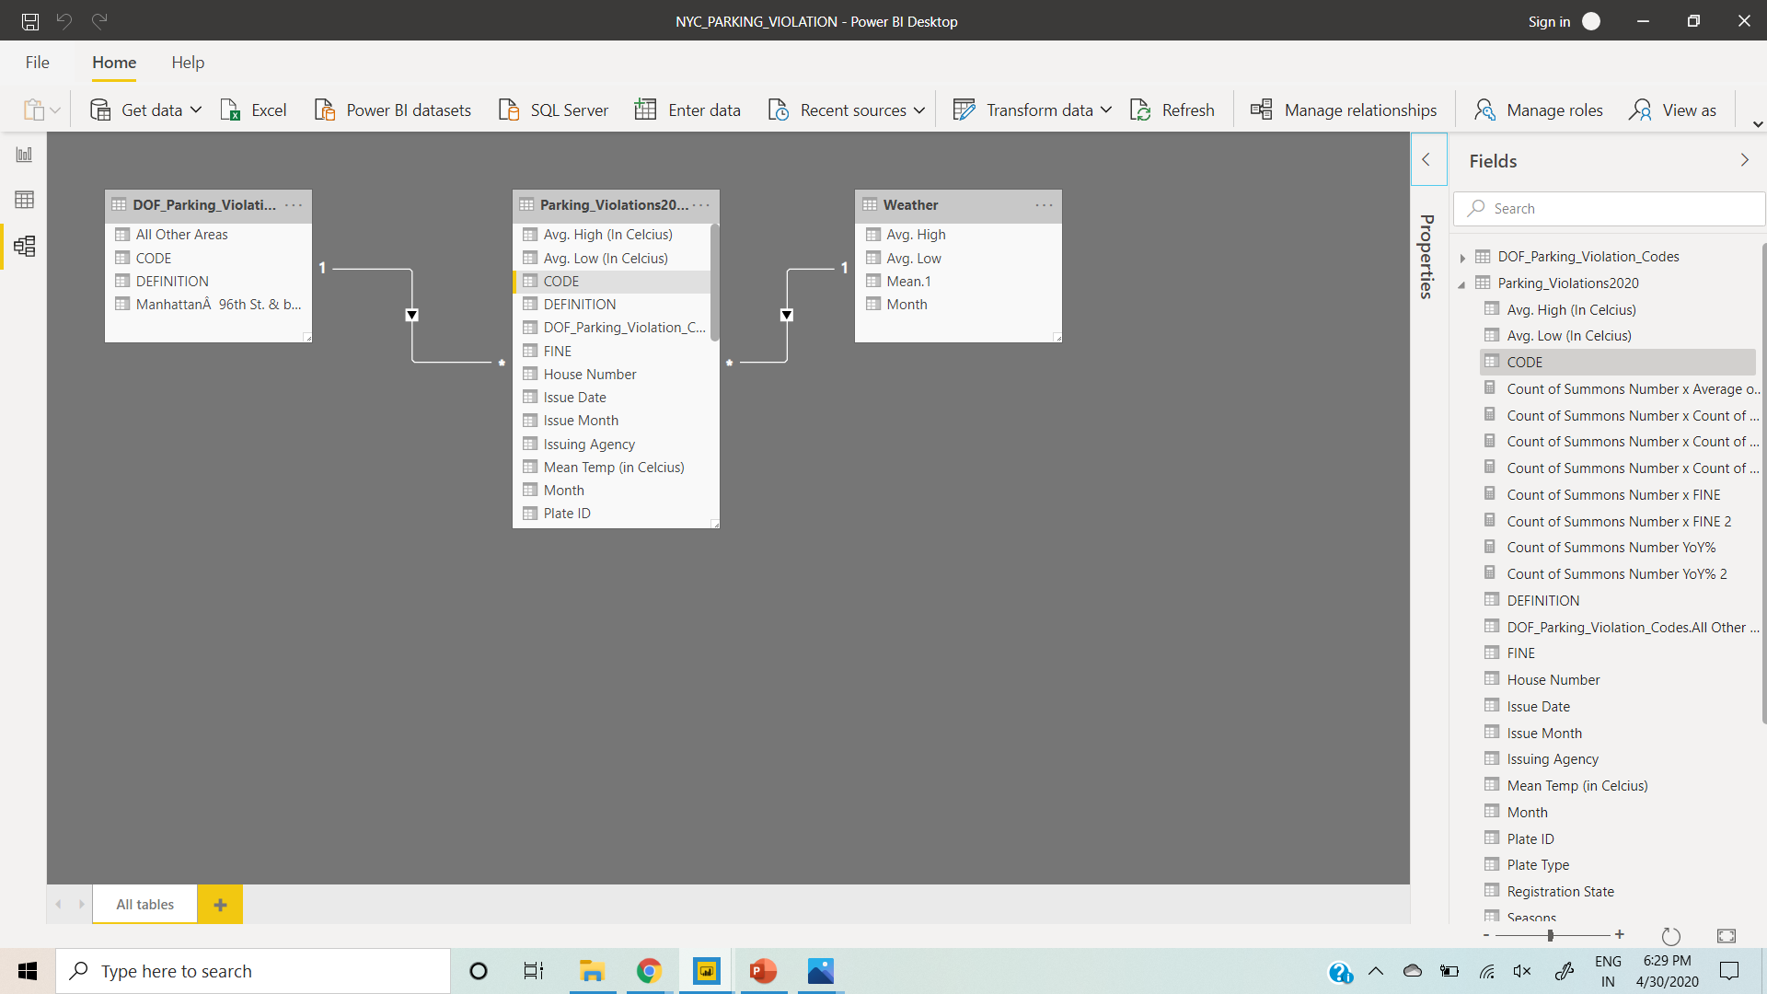

Slide 12
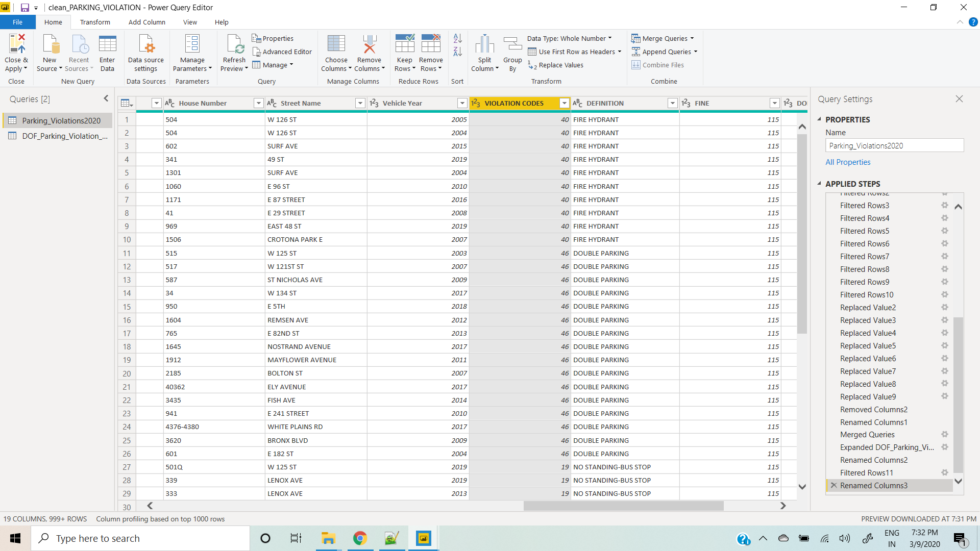

Slide 13
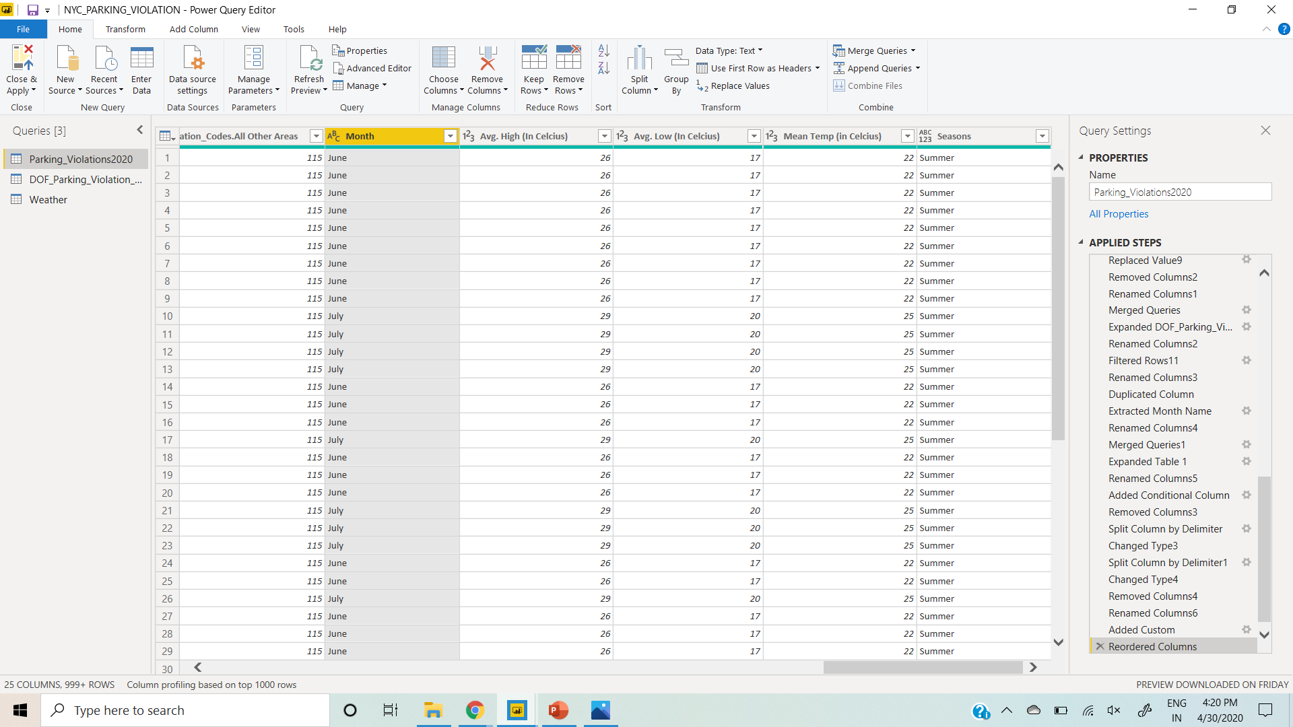

Slide 14
2. Data Merging
Merged dataset Weather conditions for LA
Common column – Weather Month (Inner Join)
Columns added – Normal High Temp. , Normal Low Temp., Monthly Normal Mean Temp. (Farenheit)

Slide 15
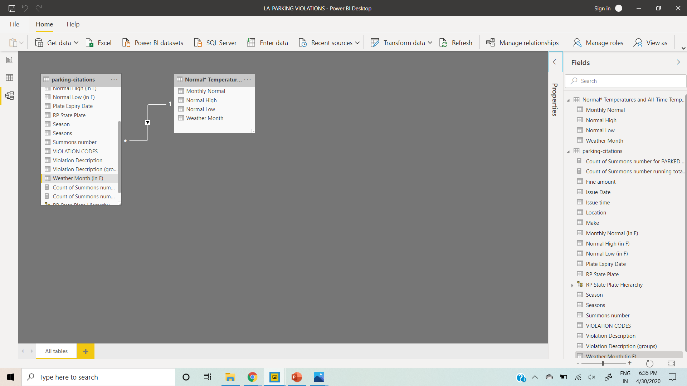

Slide 16
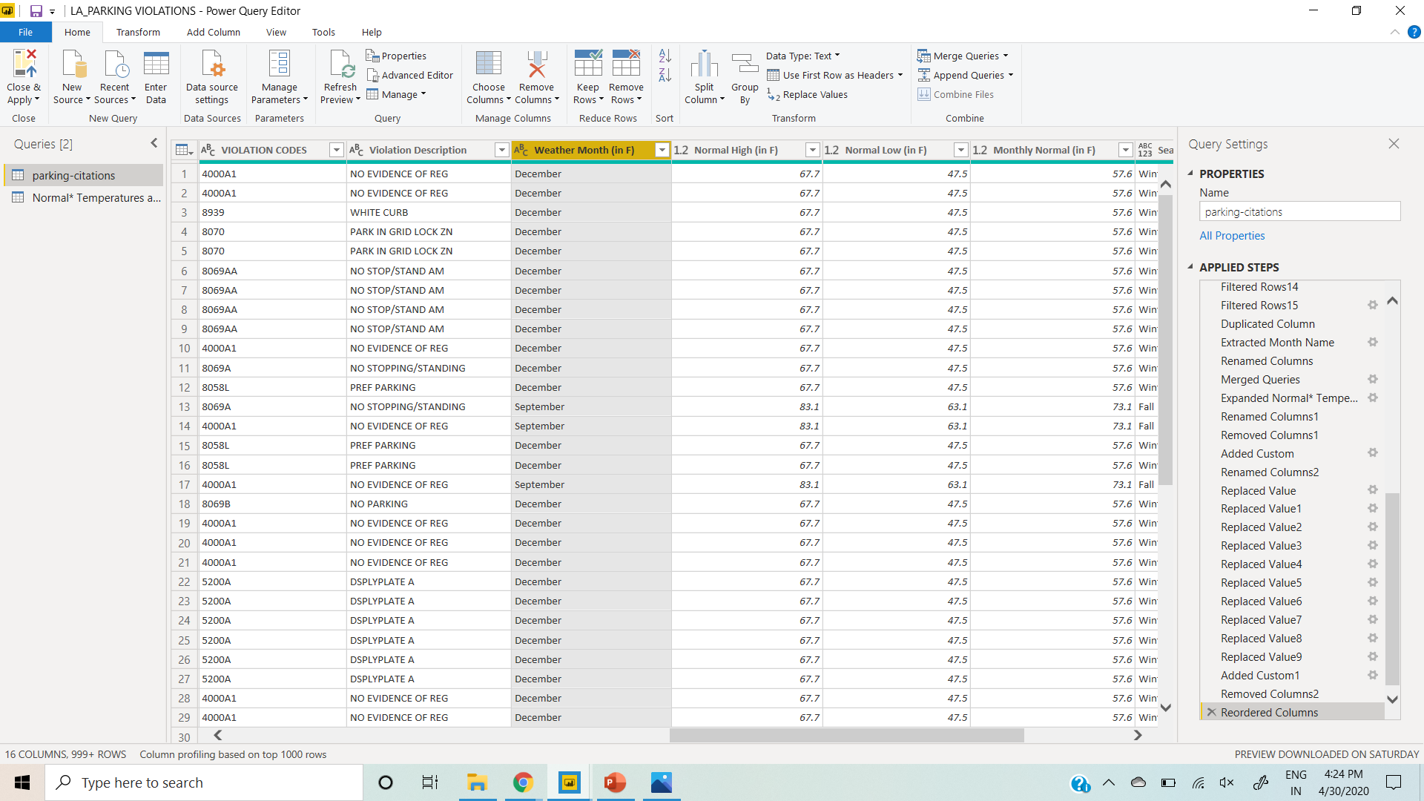

Slide 17
Analysis approach
Supervised Learning
We decided to go with supervised learning – Classification method
In this work we trained our model that maps an input to an output based on example input-output pairs. Classification basically involves assigning new input (range of temperatures) to the class (seasons) to which they most likely belong. Labelled data is used to train a classifier so that the algorithm work well on data that does not have a label. We will group the months in different classes of seasons. For eg: months ( December, January, February ) will fall under class (Winter).

Slide 18
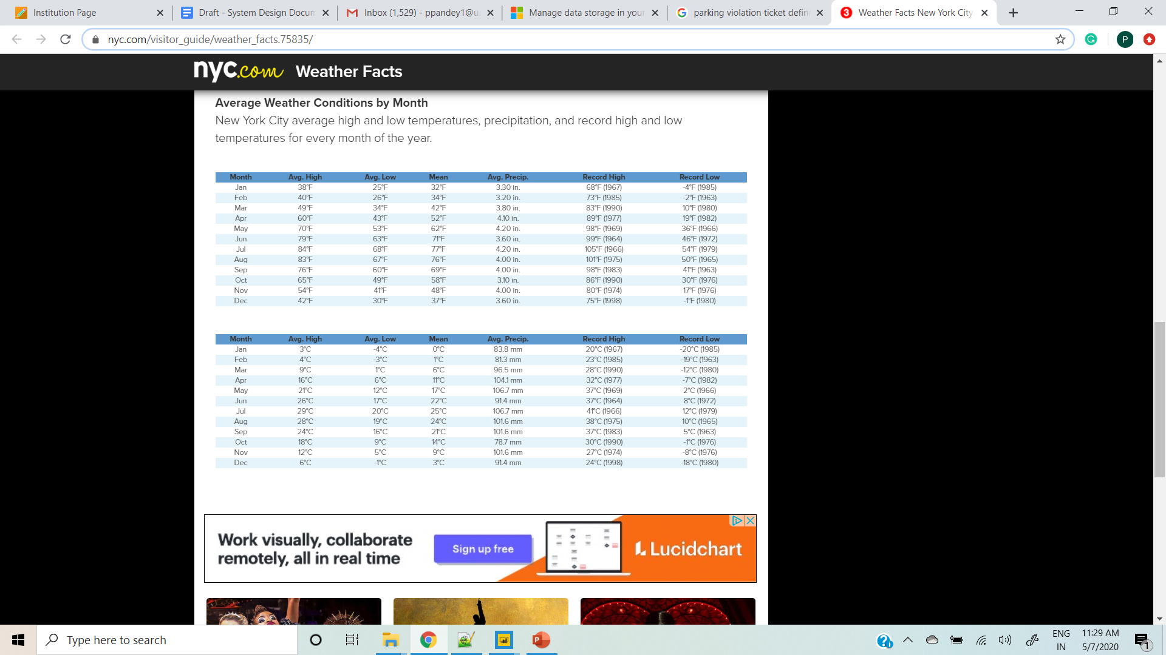
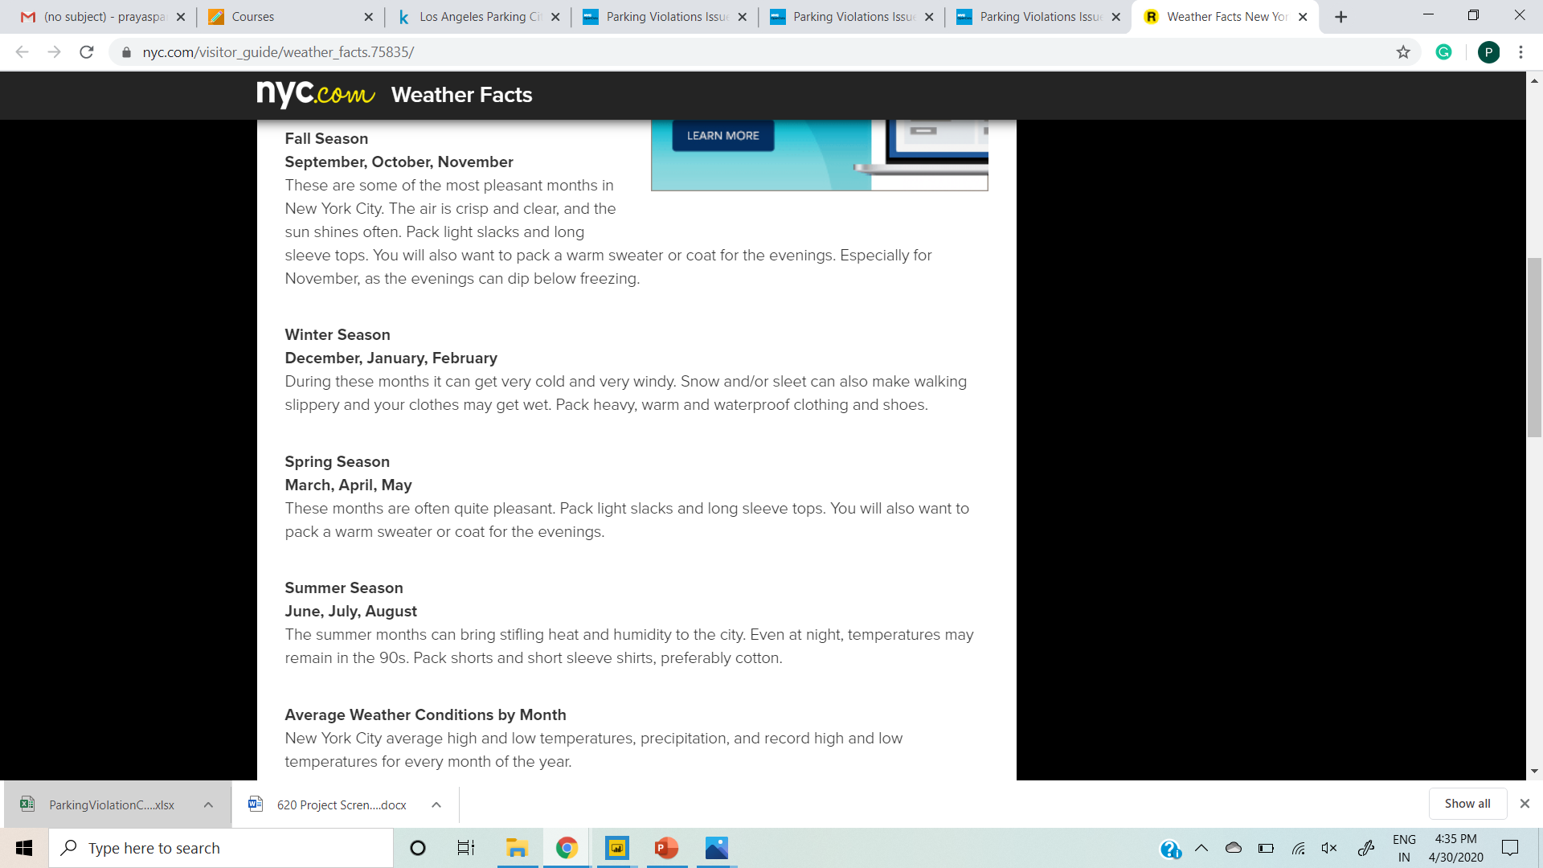
For NYC
We labelled the dataset, categorizing months into seasons based on the average high temperature, average low temperature and Mean temperature for that month using DAX command and created a custom column name “Seasons”
Seasons is again categorized in Fall, Winter, Spring and Summer.

Slide 19
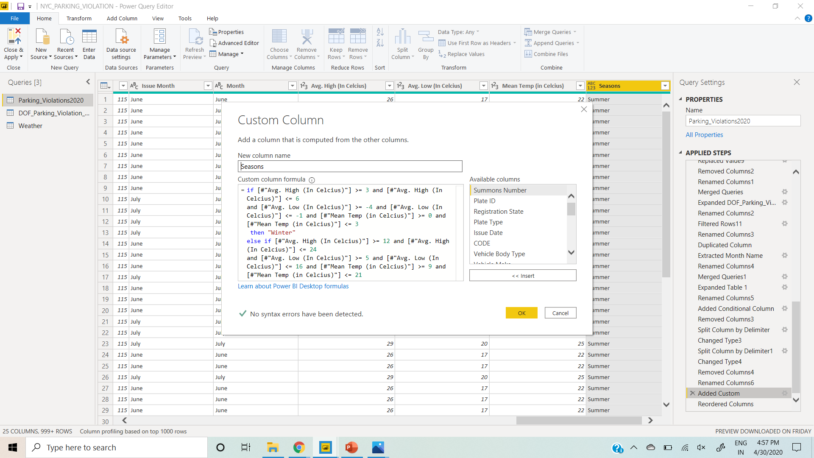

Slide 20
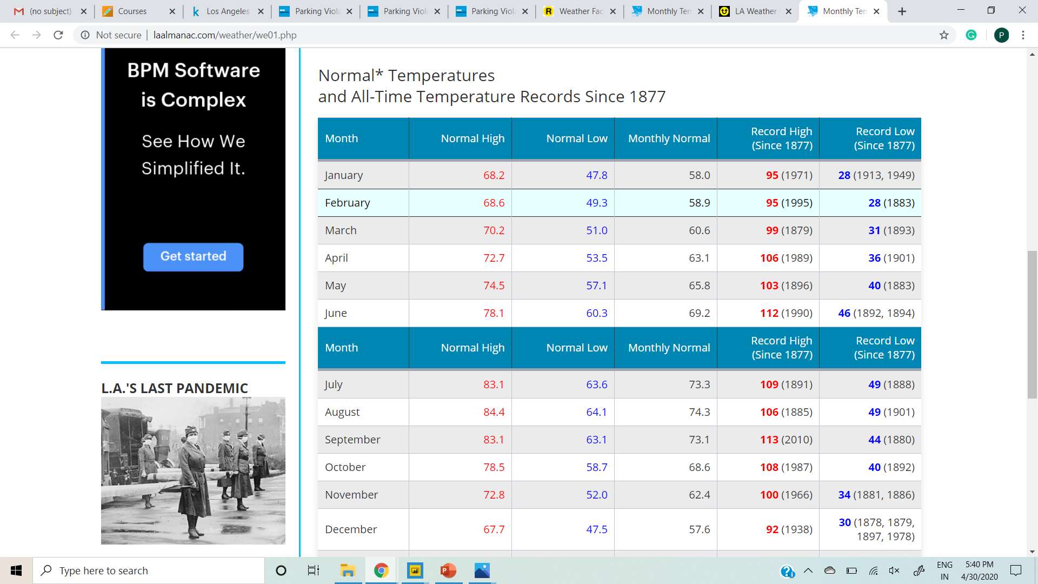
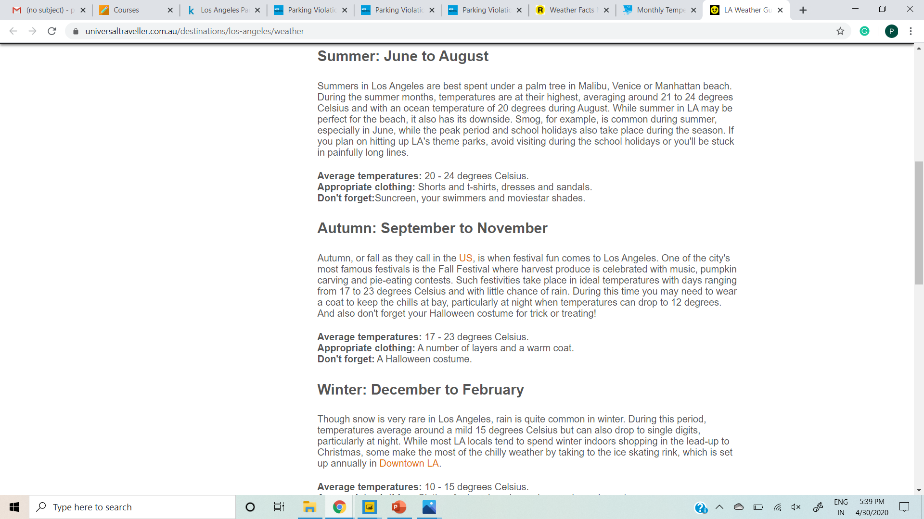
For LA

Slide 21
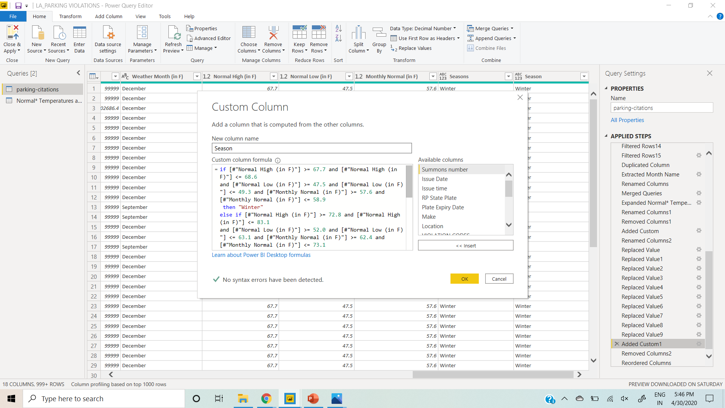

Slide 22
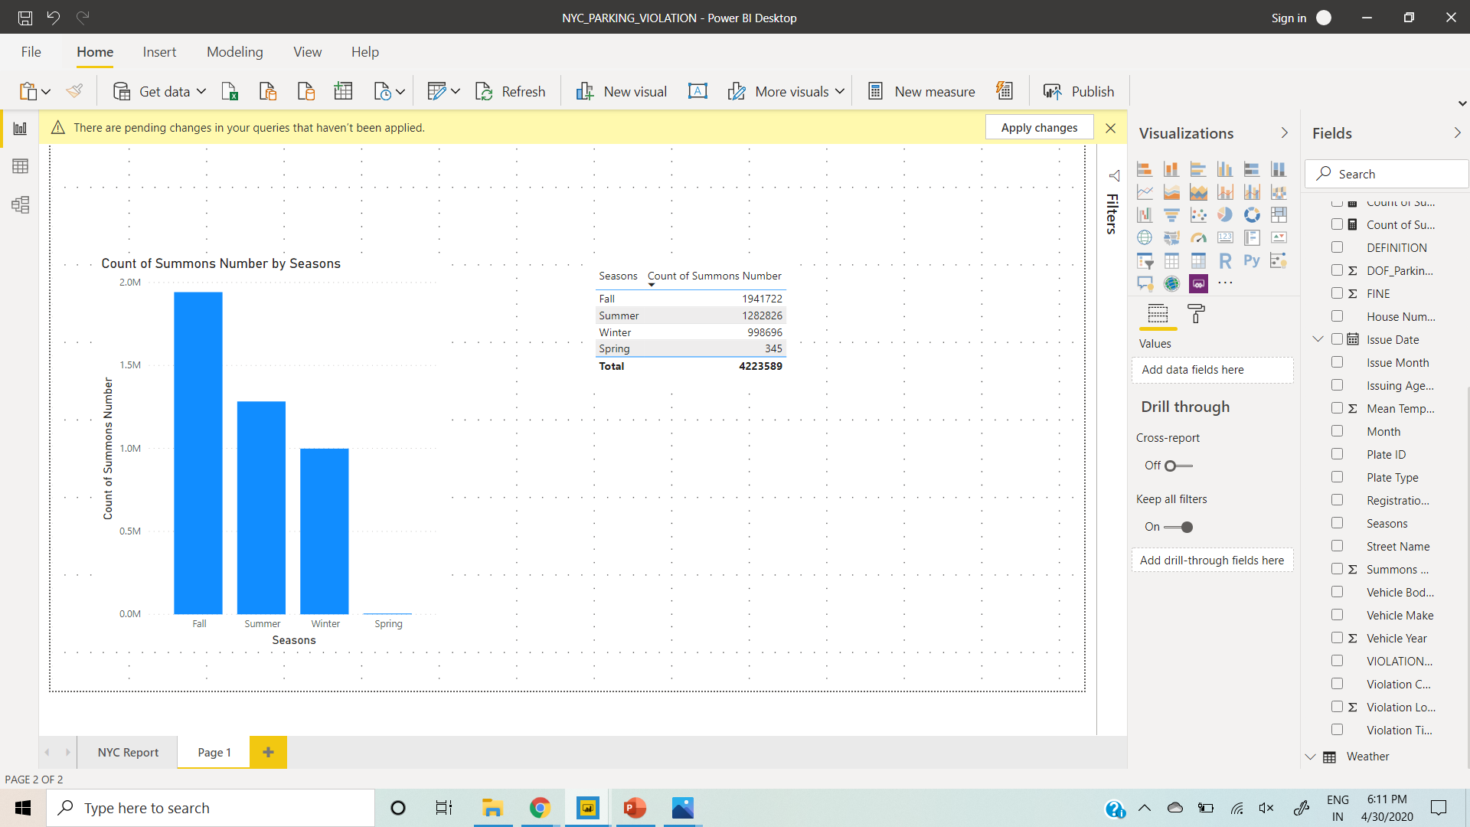
Season with the most number of parking violations issued in New York

Slide 23
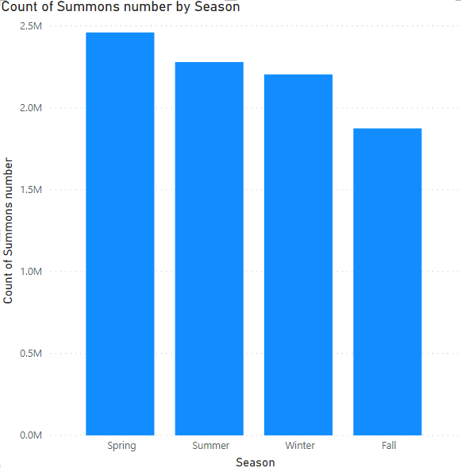
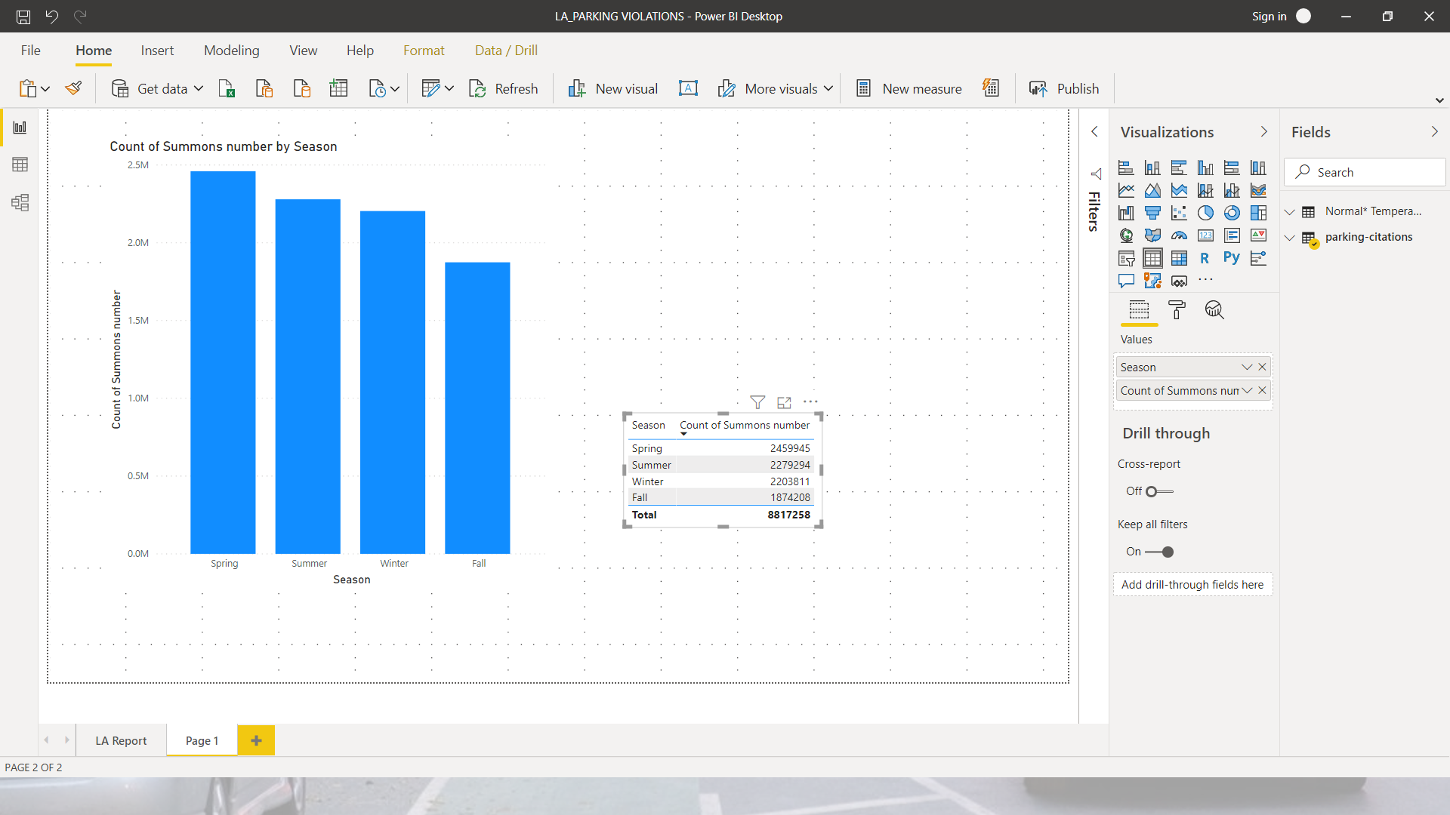
Season with the most number of parking violations issued in Los Angeles

Slide 24
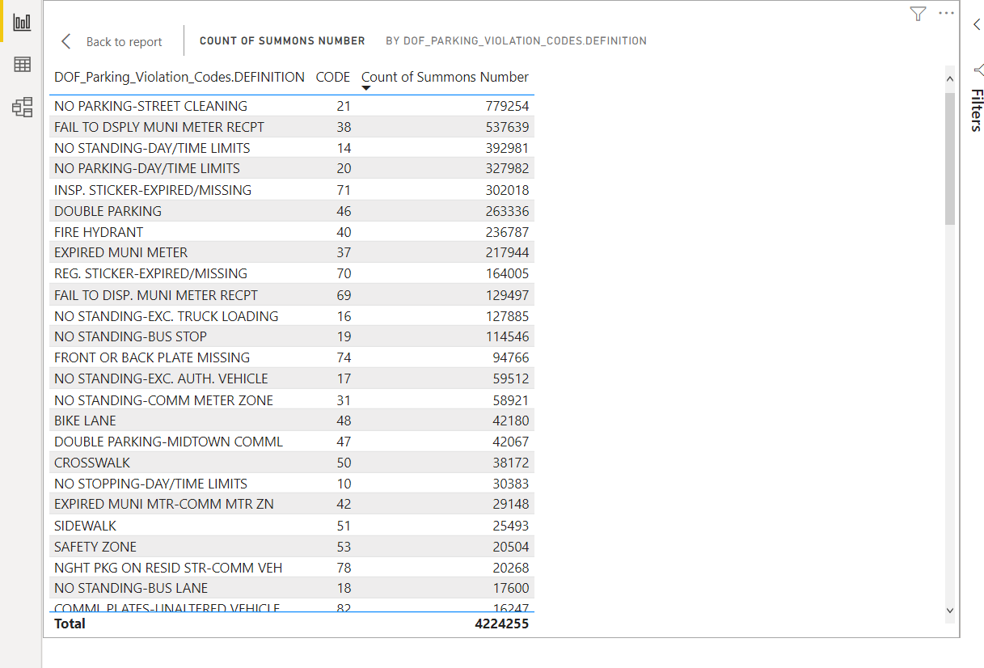
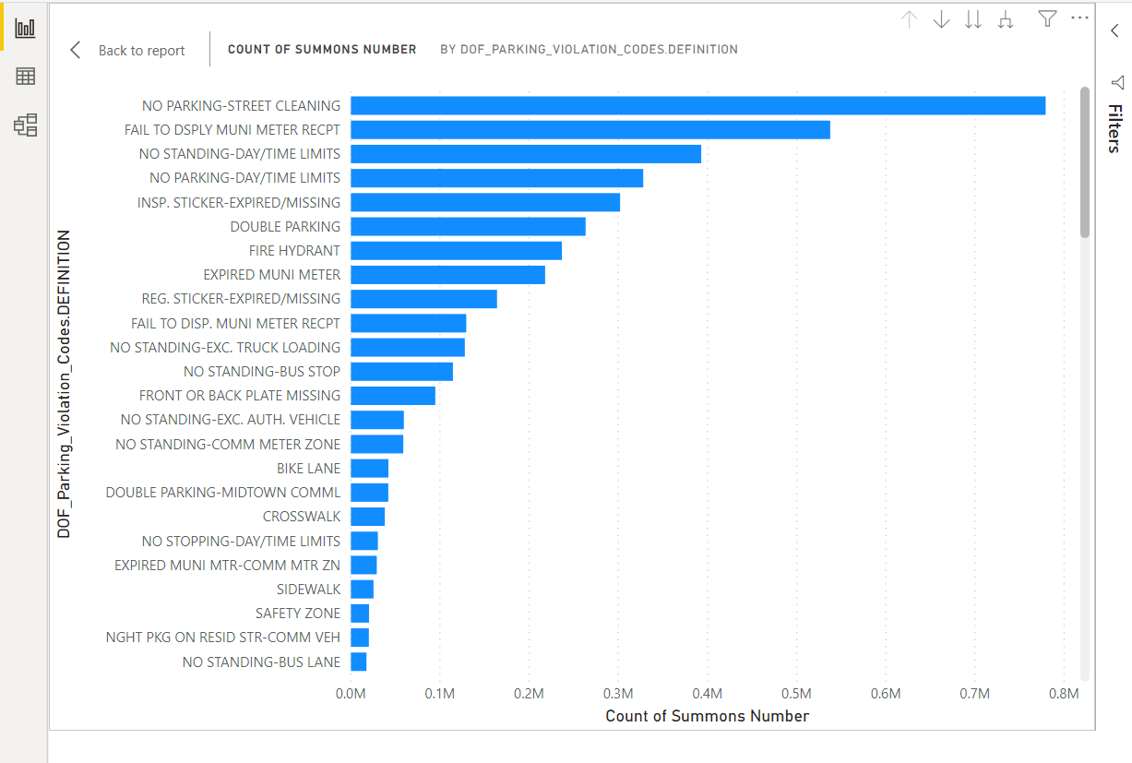
Relatable analysis for New York
Which is the most common type of violation?

Slide 25
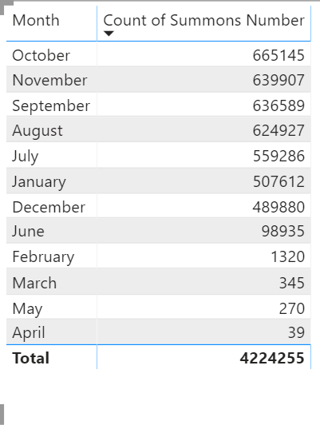
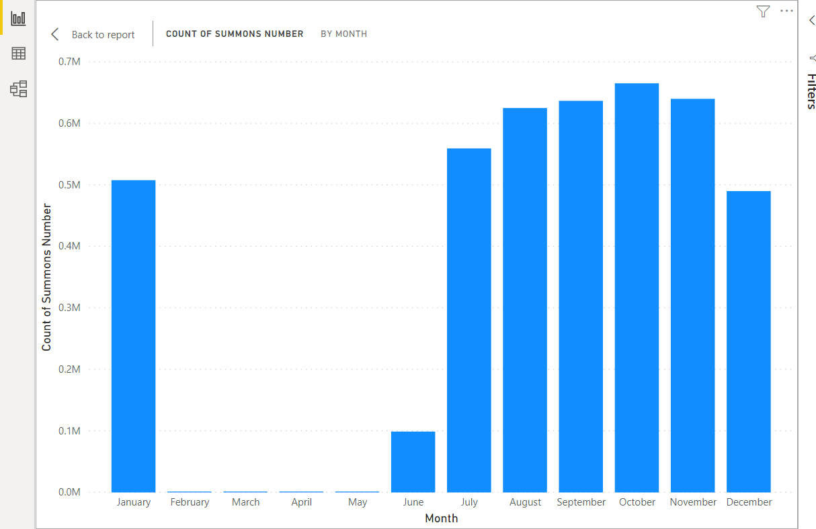
Relatable analysis for New York
During which month there were most violations?

Slide 26
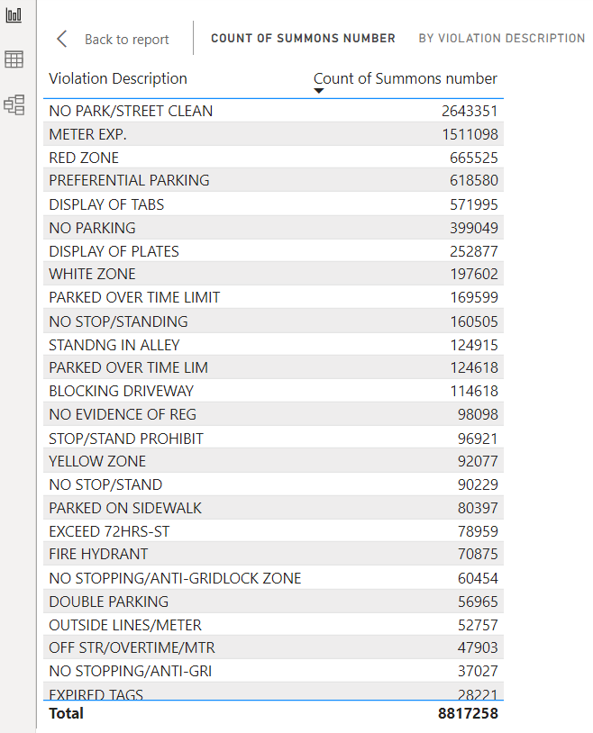
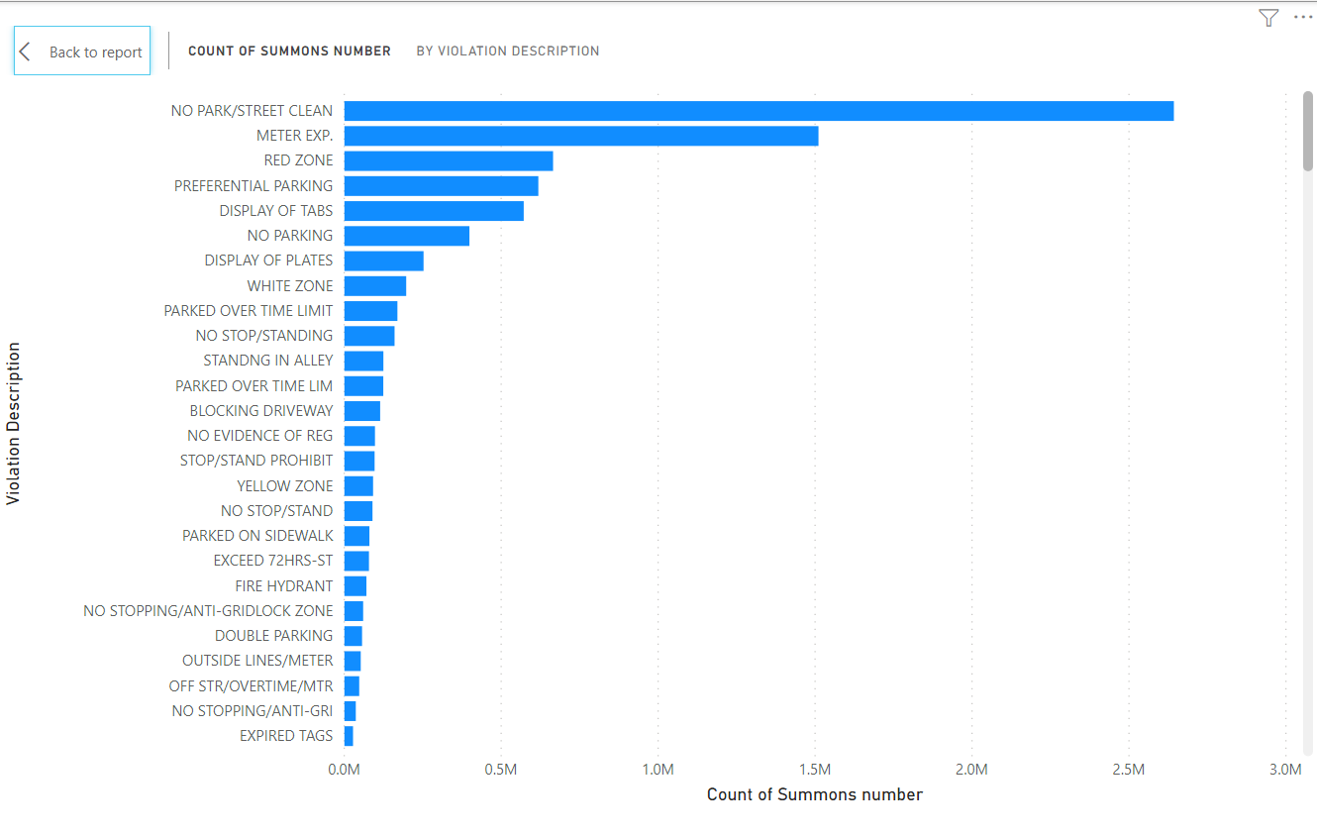
Relatable analysis for Los Angeles
Which is the most common type of violation?

Slide 27
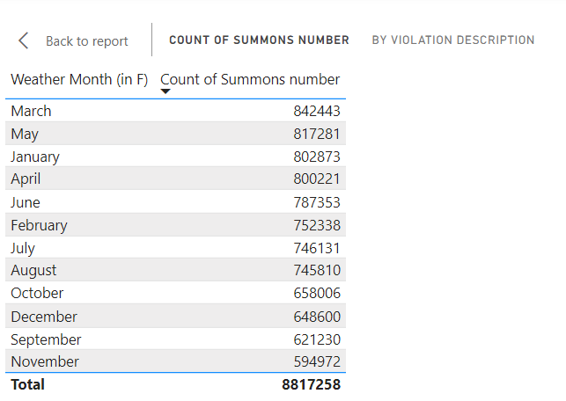
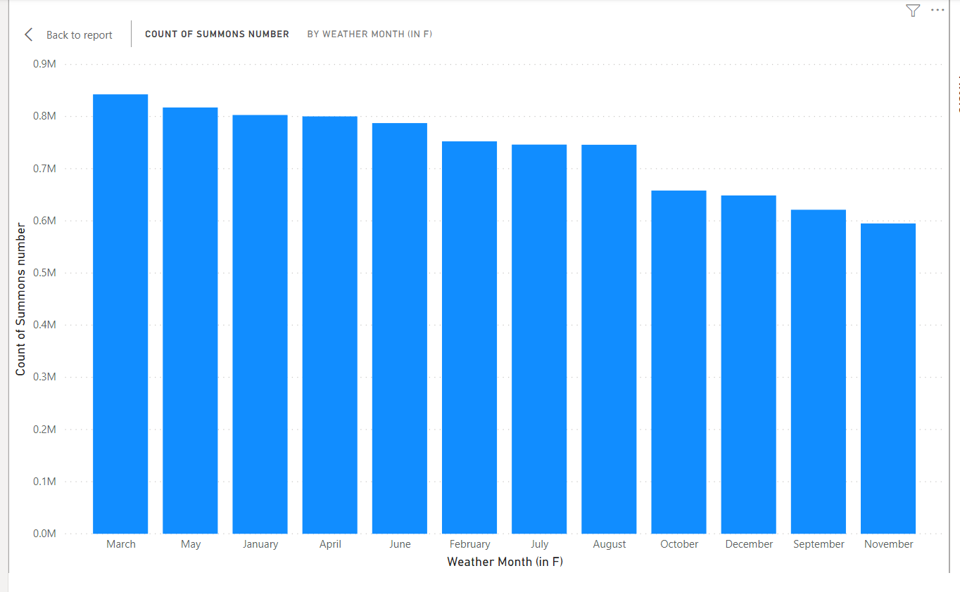
Relatable analysis for Los Angeles
During which month there were most violations?

Slide 28
HYPOTHESIS: -More parking violation tickets are issued during Summer Season
So, by analyzing the data and studying the visualization reports of parking violations datasets of LA and NYC, we can clearly say that our hypothesis was wrong . The season FALL in NYC and SPRING in LA has most number of parking violation tickets issued.

Slide 29
Thankyou!!!

